Slide 1
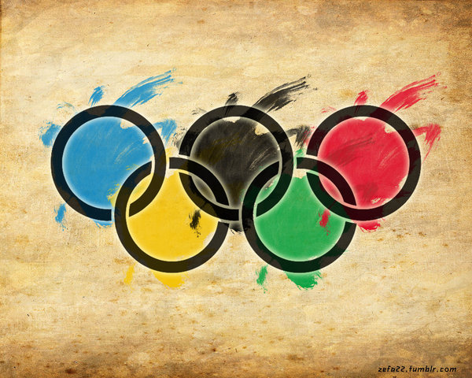
Going for Gold in Figurative Language

Slide 2
Similes
Similies compare two objects or people that have little in common.
Similies usually use the words “like” or “as”

Slide 3
Similes- Your Turn!
Think about the Winter Olympics.
Create at least 5 similies to describe the sports or the athletes.
For example: The skier flew down the mountain like an eagle on the hunt.
Once you are done share with a partner.

Slide 4
Metaphors
A metaphor is a figure of speech that is used to make a comparison between two things that aren't alike but do have something in common.
Unlike a similie, a metaphor does not use “like” or “as”

Slide 5
Metaphors- Your Turn
Think about the Winter Olympics.
Create at least 5 metaphors to describe the sports or the athletes.
For example: Ice skaters are spinning tops on the ice.
Once you are done share with a partner.

Slide 6
Onomatopoeia
Onomatopoeia is using words that describe the sound an object makes.
Ex. “Pow” “Bam” “Moo” “Meow”

Slide 7
Onomatopoeia- Your Turn!
Think about the Winter Olympics.
Create at least 5 sentences using onomatopoeia to describe the sports or the athletes.
For example: Skiers swished around each gate on the mountain.
Once you are done share with a partner.

Slide 8
Alliteration
Alliteration is the repeated use of the initial sound of a word.
Ex. Skiers swished and swooshed as they slayed the slalom.

Slide 9
Alliteration- Your Turn!
Think about the Winter Olympics.
Create at least 5 sentences using alliteration to describe the sports or the athletes.
For example: Curlers cringed and cried as their turn cost them the win.
Once you are done share with a partner.

